Slide 1


Department of BES-1
COURSE: Data Structures using Python
COURSE CODE: 24SC1204
Topic:
BINARY SEARCH TREE
Session - 26

Slide 2



AIM OF THE SESSION
To familiarize students with the basic concept of Binary search tree
INSTRUCTIONAL OBJECTIVES
This Session is designed to:
Demonstrate to search a node in BST
Demonstrate to find out smallest and largest node in BST
LEARNING OUTCOMES
At the end of this session, you should be able to:
Summarize the concept of binary search tree
Search a node in BST
Find out largest node in BST
Find out Smallest node in BST

Slide 3
INTRODUCTION
Search a node in BST:
Algorithm
Here k is the key that is searched for and x is the start node.
BST-Search(x, k)
1: y ← x
2: while y 6= nil do
3: if key[y] = k then return y
4: else if key[y] < k then y ← right[y]
5: else y ← left[y]
6: return (“NOT FOUND”)

Slide 4
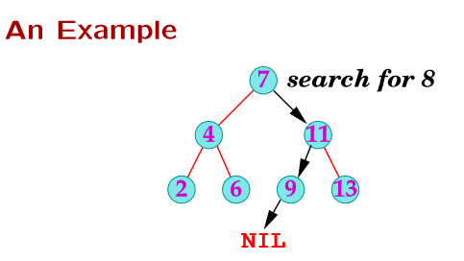
DESCRIPTION
Search a node in BST:

Slide 5
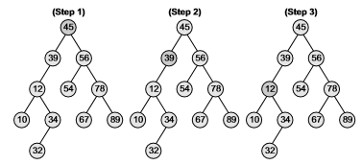
DESCRIPTION
Search a node in BST:
Ex: Searching a node 12 in BST

Slide 6
DESCRIPTION
To find Largest node in BST: Algorithm
findLargestElement(TREE)
Step 1: IF TREE=NULL OR TREE->RIGHT=NULL
Return TREE
ELSE Return findLargestElement(TREE->RIGHT)
[END OF IF]
Step 2: END

Slide 7
DESCRIPTION
To find Smallest node in BST: Algorithm
findSmallestElement(TREE)
Step 1: IF TREE=NULL OR TREE->LEFT=NULL
Return TREE
ELSE Return findSmallestElement(TREE->RIGHT)
[END OF IF]
Step 2: END

Slide 8
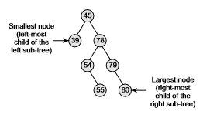
DESCRIPTION
To find Smallest node in BST:

Slide 9
SELF-ASSESSMENT QUESTIONS
1. In a binary min heap containing n elements, the largest element can be found in __________ time.
a) O(n)
b) O(nlogn)
c) O(logn)
d) O(1)
The procedure FindMin() to find the minimum element and the procedure DeleteMin() to delete the minimum element in min heap take _________
a) logarithmic and linear time constant respectively
b) constant and linear time respectively
c) constant and quadratic time respectively
d) constant and logarithmic time respectively

Slide 10
TERMINAL QUESTIONS
1. How to find Smallest node in BST
2.How to find largest node in BST
3. How to search a node in BST

Slide 11
ACTIVITIES/ CASE STUDIES/ IMPORTANT FACTS RELATED TO THE SESSION
Add the following values one at a time to an initially empty binary search tree :
10,23,85,44,26,89,62,45,89
Write a procedure to search maximum node.

Slide 12
REFERENCES FOR FURTHER LEARNING OF THE SESSION
Reference Books
Data Structures and Algorithm Analysis in PYTHON, 2010, Mark Allen Weiss, Second Edition, Pearson Education.
Data Structures and Algorithms, A.V.Aho, J.E.Hopcroft, and J.D.Ullman, Pearson Education, First Edition Reprint2003.
Advanced Guide to Python 3 Programming, John Hunt, 4th Edition, Springer Nature Switzerland AG 2019.
Python Basics: A Practice Introduction to Python 3, David Amos, Dan Bader, Joanna Jablonski, Fletcher Heisler, 4th edition, Real Python
.Sites and Web links:
https://docs.python.org/3/tutorial/datastructures.html
https://www.w3schools.com/dsa/dsa_intro.php
3. https://www.geeksforgeeks.org/python-data-structures/

Slide 13
THANK YOU
Team – Data Structures using Python

